Slide 1
Air Quality Data Analysis – Review 1: EDA & Preprocessing
STUTI SHARMA 23SCSE1420048
SAKSHI PATEL 23SCSE1012075
VIDHI KANSAL 23SCSE1011011
HRISHITA PUNETHA 24SCSE1410125

Slide 2
Project Overview
This project focuses on analyzing air quality data from Indian cities to identify pollution trends.
Objectives:
- Understand pollutant distributions
- Clean and preprocess the dataset
- Handle missing values
- Generate visual insights for modeling

Slide 3
Dataset Description
• Source: Kaggle / Central Pollution Control Board (CPCB)
• Cities: Multiple Indian metro regions
• Time period: 2015–2020
• Features: PM2.5, PM10, NO2, CO, SO2, O3, AQI, Date, City
Initial analysis revealed format inconsistencies and missing values.

Slide 4
Data Cleaning
Performed the following:
• Removed duplicates
• Parsed date/time columns correctly
• Renamed columns for consistency
• Removed irrelevant/constant columns
• Normalized categorical data where needed

Slide 5
Missing Value Treatment
• Used isnull().sum() to identify missing patterns
• Interpolated time-series values
• Used mean/median imputation for numerical gaps
• Dropped rows with excessive nulls
• Verified results visually and statistically

Slide 6
Feature Selection & Transformation
• Selected key pollutants (PM2.5, PM10, NO2, CO, SO2, O3)
• Dropped highly correlated/redundant features
• Created 'Month' and 'Season' from Date for trends
• Normalized/standardized values for modeling readiness

Slide 7
Initial Visualizations
• PM2.5 Distribution → Right-skewed, spikes in winters
• Correlation Heatmap → PM2.5, PM10 strongly correlated
• AQI over time → Seasonal trends and city-wise spikes
• Boxplot by city → Pollution intensity comparison

Slide 8
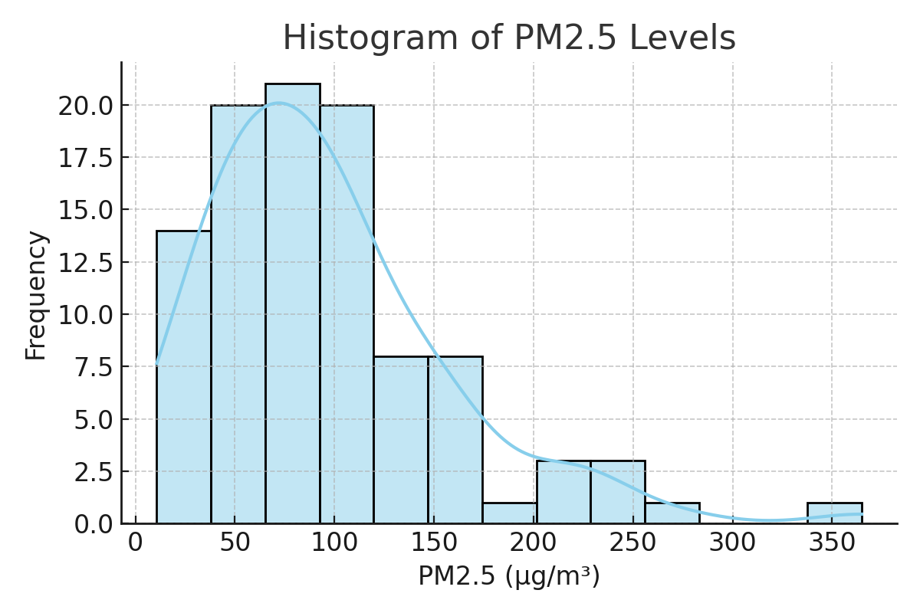

Slide 9
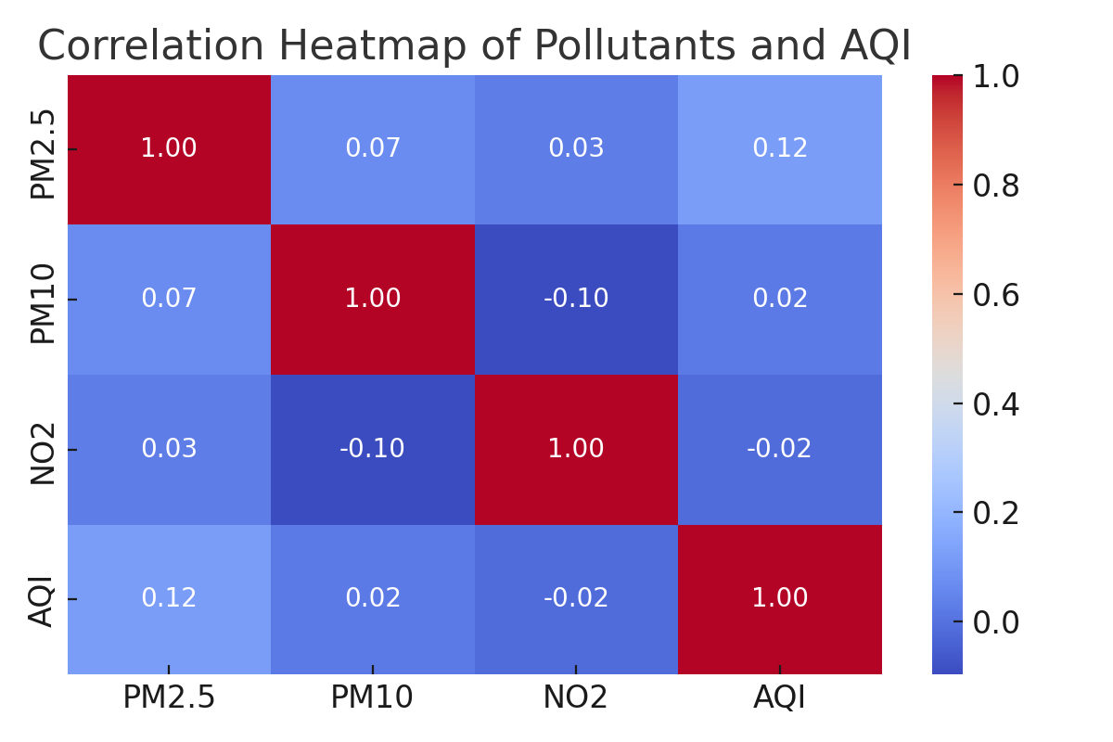

Slide 10
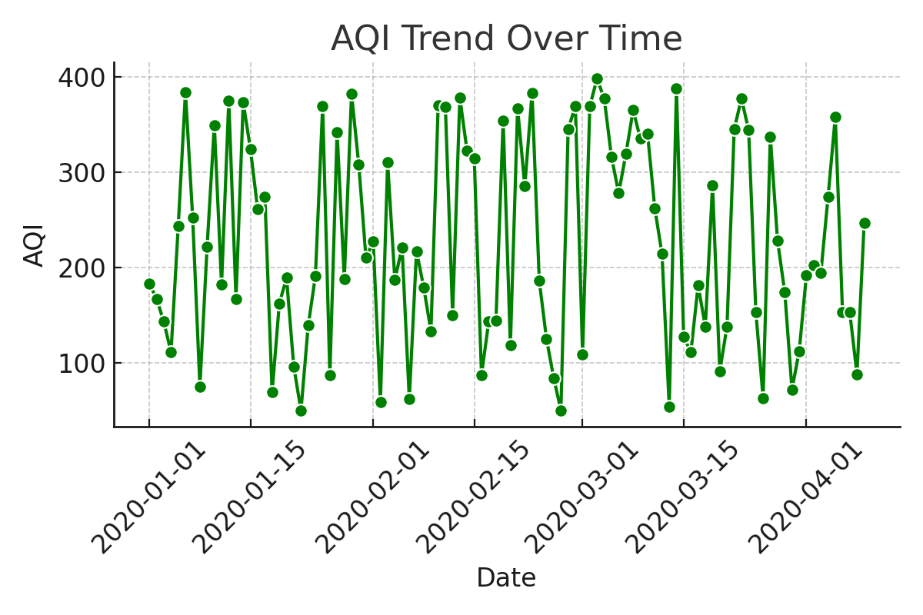

Slide 11
Summary Statistics
• PM2.5 Mean: ~105 µg/m³ | Median: 89 µg/m³
• Highest AQI recorded: 490+ in Delhi
• AQI exceeds WHO safe limits frequently
• Cities like Delhi, Ghaziabad, Noida among most polluted

Slide 12
GitHub Repository
Please refer to the public GitHub repo for:
• Jupyter notebook (.ipynb) for code and visualizations
• Cleaned data (sample only)
• README with setup instructions
• This presentation file
→ [Insert your GitHub link here before submitting]

Slide 13
Conclusion
• Dataset successfully cleaned and prepared
• Handled nulls and transformed key features
• Initial EDA insights are ready for model development
Next Steps:
• Train ML models for AQI prediction
• Apply classification or regression techniques
• Compare model accuracy and interpret results

